Slide 1
Day 1
Introduction to C++

Slide 2
Book to refer
The C++ Programming Language (4th Edition): By Bjarne Stroustrup
Use the following website for downloading this book(or any other book) = https://b-ok.asia/
Slides to refer from : https://ocw.mit.edu/courses/electrical-engineering-and-computer-science/6-096-introduction-to-c-january-iap-2011/lecture-notes/
If you attend all the classes, there won’t be much need for the use of any books.
My email ID : joelantonythomas12@gmail.com
My phone Number : 7593899893(Whatsapp), 9064599920

Slide 3
Other good websites for coding
Geeks for Geeks : https://www.geeksforgeeks.org/
Stack Overflow : https://stackoverflow.com/
Tutorials Point : https://www.tutorialspoint.com/index.htm
Github(for coding) : https://github.com/

Slide 4
Programming Languages
A programming language is a formal language comprising a set of strings that produce various kinds of machine code output. Programming languages are one kind of computer language, and are used in computer programming to implement algorithms. Most programming languages consist of instructions for computers.
High-level languages include Basic, FORTRAN, COBOL, Pascal, C, C++, C#, and Java amongst others.
Once you learn one programming language, learning others will be easy, and won’t take much time.

Slide 5
C++ is a superset of C
Features present in C are also present in C++
C++ is a object oriented programming language ( C++ = c + objects + …)
OOP is about objects which contain data and functions to manipulate that data.
A single unit that contains data and functions that operate on the data is called an object.

Slide 6
Why learn C++?
Ubiquitous (found everywhere)
Object Oriented
Easier large scale projects
Resuability
High Performance

Slide 7
C++ Features
Supports data security
Prevents accidents with data
Helps code reuse.
Lets you use operators the way you like.
Allows multiple functions/operators with the same name.

Slide 8
When to use C++?
Large projects
System applications
Graphics
Data Structures
Changes in functionality required.
Need exceptions and error handling?
Want to speed up your scripts?

Slide 9
When not to use C++?
Small system programs.
Fast prototyping.
Web-based applications (Perl/Python)

Slide 10
OOP
Based on concept of objects and classes.
Objects: Represent entities with related state and behaviour
Instances of a class
Classes: Define common characteristics of similar objects.

Slide 11
Important definitions
Algorithm: Ordered set of actions to accomplish a certain task.
Program: Implementation of algorithms.
Compiler, function, library, bug.
Variables, constants.
Keywords (if, while, for,…)
Data Types. (long, int, …)

Slide 12
Lets now download and use an IDE
IDE - Integrated development environment
IDE helps in translating the high level programming code(C++ in our case) to something the computer will understand.
Various IDEs can be used. Example : Visual Studio Code, Code::Blocks, Eclipse, Dev-C++, etc.
I will be showing the installation process for Dev-C++.

Slide 13
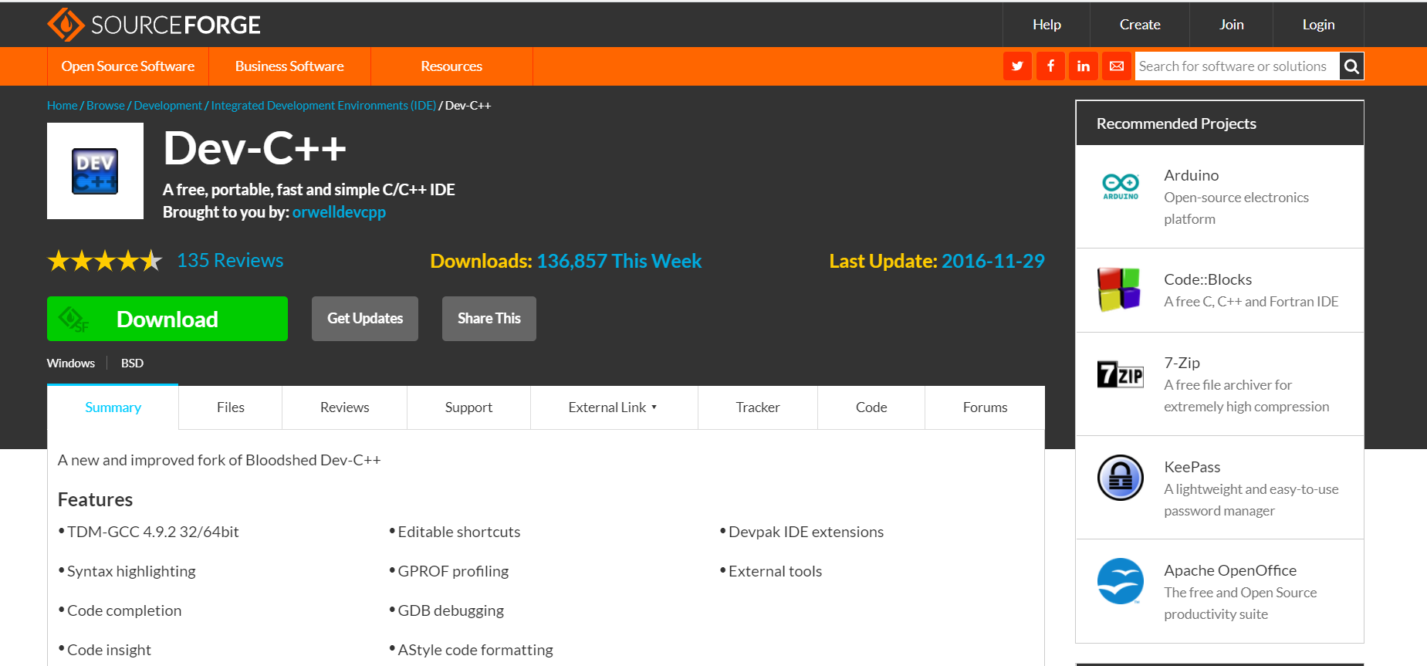
Installing Dev-C++
Go to the website https://sourceforge.net/projects/orwelldevcpp/
Click the Download button. Download the .exe file somewhere convenient.

Slide 14
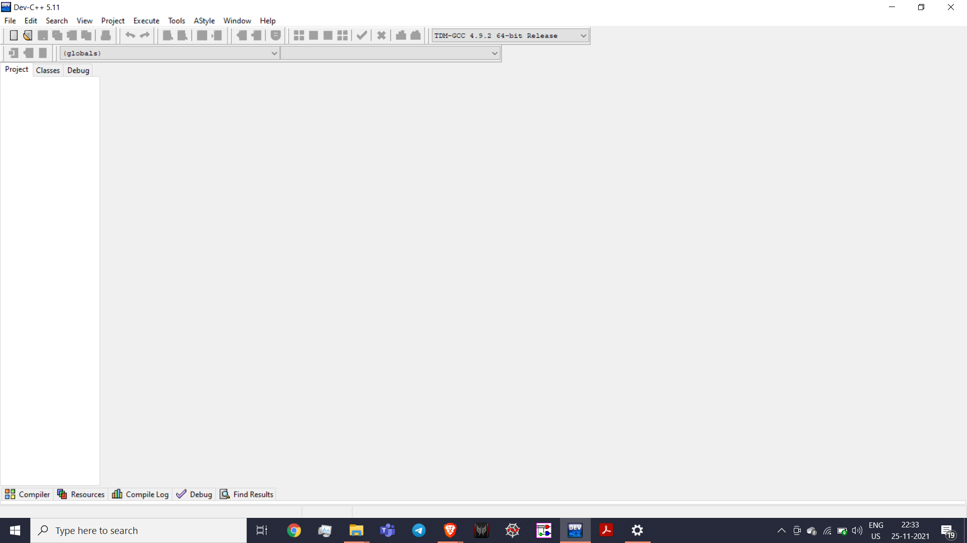
Installing Dev-C++
After download is complete, double click on the file to run the SetUp.
Run the SetUp as instructed.
It’s a good idea to add it as a shortcut to the Desktop.

Slide 15
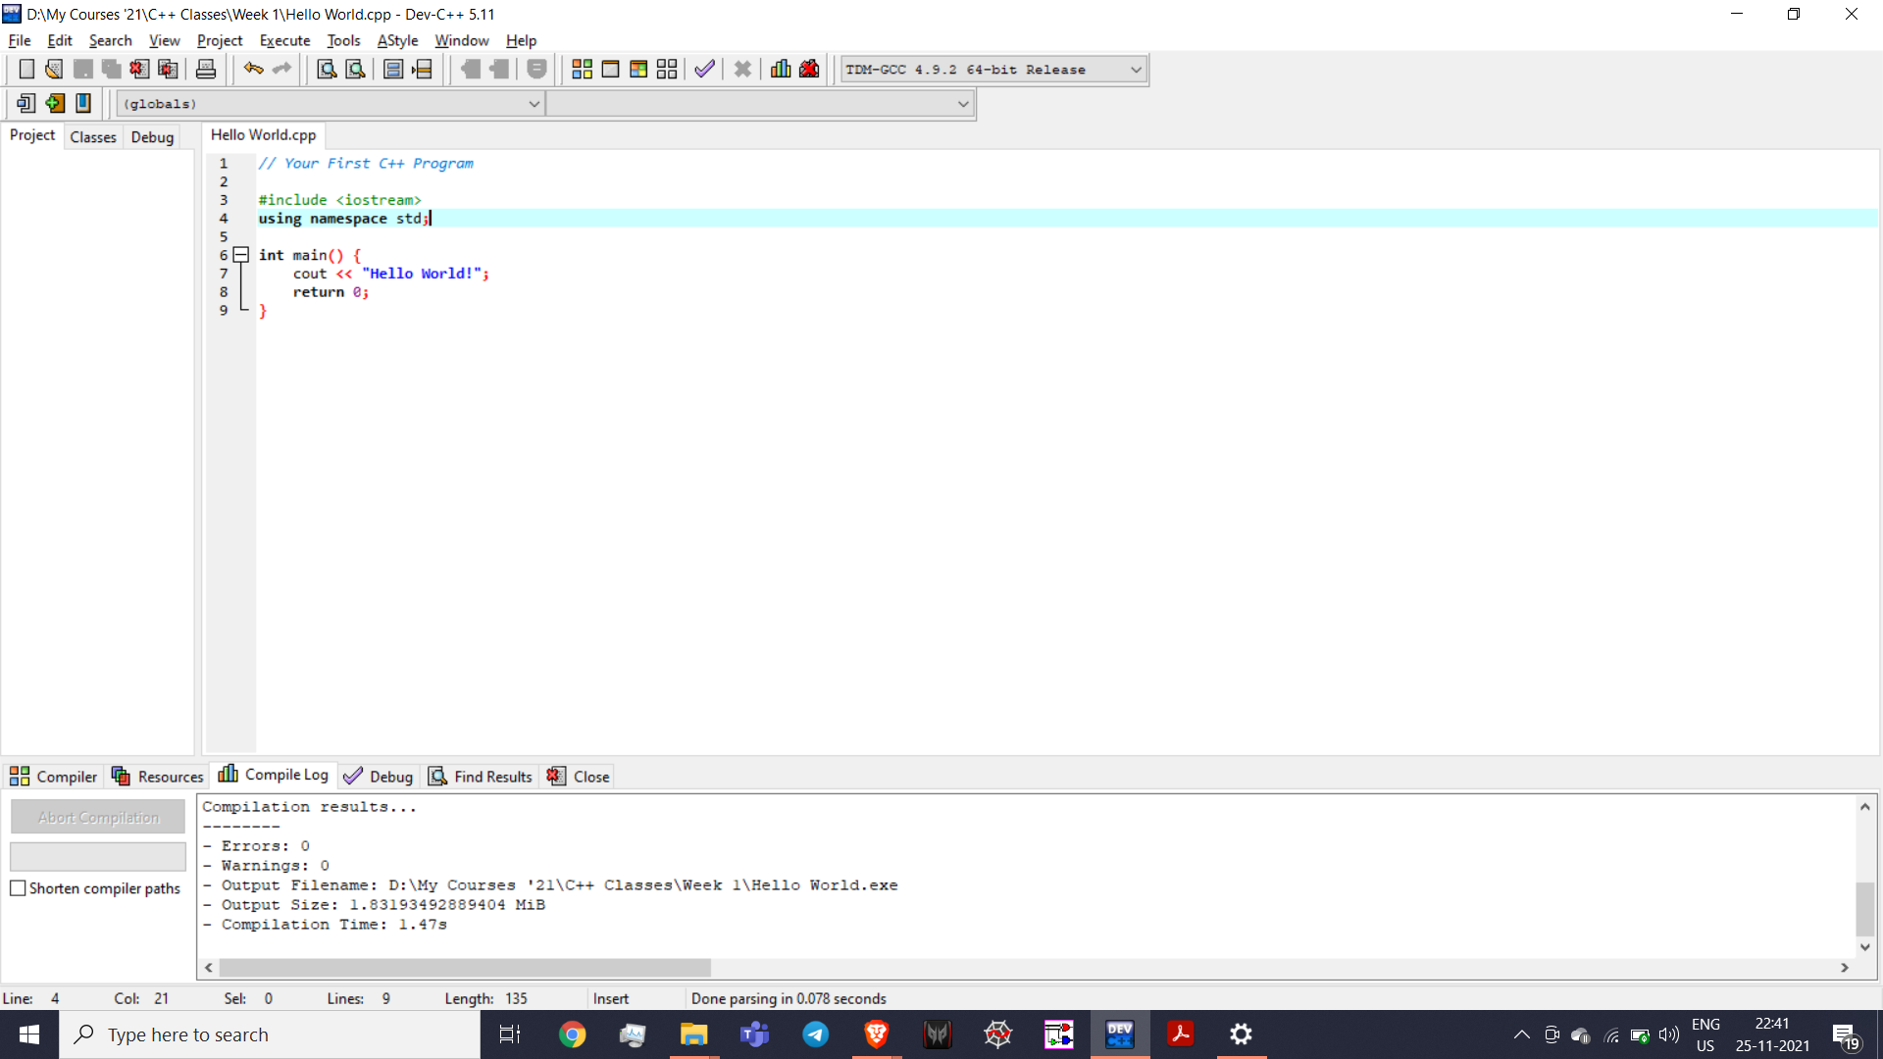
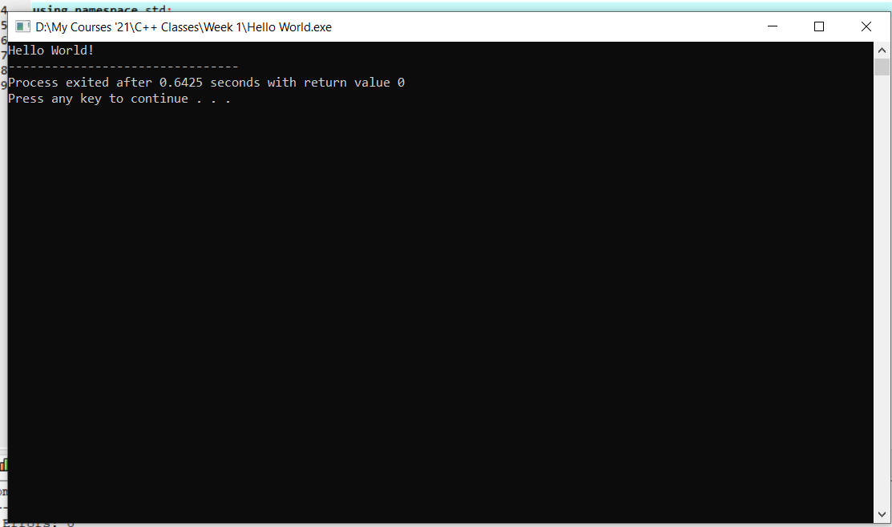
Installing Dev-C++
Click File => New => Source file (or Control + N) to open a new file to code in.

